Slide 1


Green Pace
Security Policy Presentation
Developer: Richard Chang
Date:4/13/23
Notes:
Welcome Green Pace to the Security Policy Presentation.

Slide 2

OVERVIEW: DEFENSE IN DEPTH
Defense in Depth is a plan that practices implementations of multiple security layers to protect an organization’s assets. When one layer is broken, another layer may hold against a threat. With ongoing cyberattacks, multiple layers stop threats that attempt to steal, hack, or damage the organization.
Notes:
Let’s talk about defense in depth. As the illustration shows, security has many layers. Defense in Depth is a plan that practices implementations of multiple security layers to protect an organization’s assets. When one layer is broken, another layer may hold against a threat.

Slide 3
THREATS MATRIX
The higher the likelihood, the higher the priority. In vice versa, the lower the likelihood, the lower the priority.
Likely STR30-C STR02-C EXP46-C | Priority STR30-C STR02-C EXP46-C
Low Priority DCL12-C DCL03-C SIG35-C PRE30-C | Unlikely DCL12-C DCL03-C SIG35-C PRE30-C FIO47-C
Notes:
I have compiled a list of 10 security threats in coding practice. The matrix places threats in likely, priority, low priority, and unlikely. As a summary, the higher the likelihood, the higher the priority. In vice versa, the lower the likelihood, the lower the priority.

Slide 4
10 PRINCIPLES
Validate Input Data:DCL12-C, CON32-C, PRE30-C
Heed Complier Warnings:INT31-C, STR30-C
Architect and Design for Security Policies:CON32-C
Keep It Simple:INT31-C, STR30-C, SIG35-C, PRE30-C, EXP46-C, FIO47-C
Default Deny:
Adhere to the Principle of Least Privilege:
Sanitize Data Sent to Other Systems:DCL12-C, STR02-C
Proactive Defense in Depth:
Use Effective Quality Assurance Techniques:SIG35-C, FIO47-C
Adopt a Secure Coding Standard:
Notes:
Here are the 10 coding principles. Validate Input Data, Heed Compile Warnings, Architect and Design for Security Policies, Keep It Simple, Default Deny, Adhere to the Principle of Least Privilege, Sanitize Data Sent to Other Systems, Proactive Defense in Depth, Use Effective Quality Assurance Techniques, Adopt a Secure Coding Standard. Security threats are listed next to each one.

Slide 5
CODING STANDARDS
My ranking (under My Ranking column) is based on the following importance: priority, likelihood, remediation cost.
Rule | Severity | Likelihood | Remediation Cost | Priority | Level | My Ranking
DCL12-C | Low | Unlikely | High | P1 | L3 | 6
INT31-C | High | Probable | High | P6 | L2 | 4
STR30-C | Low | Likely | Low | P18 | Low | 1
STR02-C | High | Likely | Medium | P18 | L1 | 2
CON32-C | Medium | Probable | Medium | P8 | L2 | 5
DCL03-C | Low | Unlikely | High | P1 | L3 | 7
SIG35-C | Low | Unlikely | High | P1 | L3 | 8
PRE30-C | Low | Unlikely | Medium | P2 | L3 | 9
EXP46-C | Low | Likely | Low | P9 | L2 | 3
FIO47-C | High | Unlikely | Medium | P6 | L2 | 10
Notes:
This table shows the rule violation and many field topics such as severity and likelihood. My ranking is shown to the right of the table and is based on the following importance: priority, likelihood, remediation cost

Slide 6
ENCRYPTION POLICIES
Encryption | What? Example?
Encryption in rest | Encryption in rest is encryption of data that is stored on disk or hard memory. Most of the data is meant to be private and kept confidential. Using role-based accounts authentication and multi factor authentication are ways to secure data.
Encryption at flight | Encryption at flight is encryption of data that is in transit. Data moves fast all the time from client to server. Maintaining a secure network and proper security transfer protocol transfer data securely. A VPN is a tool that provides private, encrypted access to a network.
Encryption in use | Encryption in use is encryption that prevents data visibility when data is at rest or in motion. Encryption in use covers access to databases and websites, and cloud infrastructure. Defense in depth is a strategy that adds multiple layers of security features to the customer.
Notes:
Here are 3 stages of encryption strategy.
Encryption in rest is encryption of data that is stored on disk or hard memory. Most of the data is meant to be private and kept confidential. Using role-based accounts authentication and multi factor authentication are ways to secure data.
Encryption at flight is encryption of data that is in transit. Data moves fast all the time from client to server. Maintaining a secure network and proper security transfer protocol transfer data securely. A VPN is a tool that provides private, encrypted access to a network.
Encryption in use is encryption that prevents data visibility when data is at rest or in motion. Encryption in use covers access to databases and websites, and cloud infrastructure. Defense in depth is a strategy that adds multiple layers of security features to the customer.

Slide 7
TRIPLE-A POLICIES
Triple-A Framework* | Explain what it is and how and why the policy applies.
Authentication | Authentication uses user logins, passwords, RSAs, network sign ins, fingerprinting, MFA, and so on to check the identity of the user.
Authorization | Authorization gains the role to do certain tasks. Enforcing policies determines the activities, resources, and services that are in use. Certain security levels give the user the ability to change personal data in a CRUD (create read update delete) application.
Accounting | Accounting uses the features from authentication and authorization to keep records. The amount of system time or amount of data tracks the user during a session. Logging these statistics may prove to be an indicator of unauthorized use.
Notes:
I will discuss Triple A framework as a security practice.
Authentication uses user logins, passwords, RSAs, network sign ins, fingerprinting, MFA, and so on to check the identity of the user.
Authorization gains the role to do certain tasks. Enforcing policies determines the activities, resources, and services that are in use. Certain security levels give the user the ability to change personal data in a CRUD (create read update delete) application.
Accounting uses the features from authentication and authorization to keep records. The amount of system time or amount of data tracks the user during a session. Logging these statistics may prove to be an indicator of unauthorized use.

Slide 8
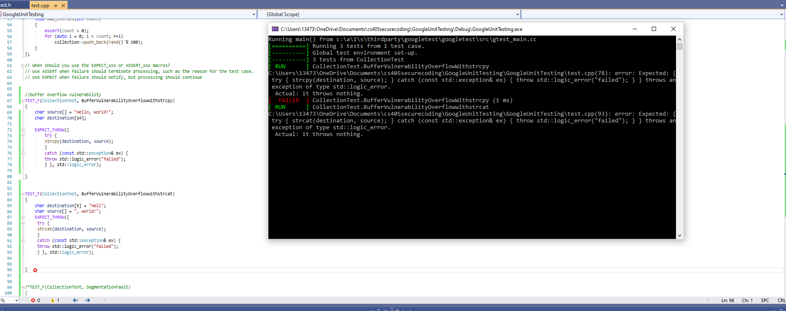
Unit Testing
A negative BufferVulnerabilityOverflowWithstrcpy test that yields a buffer overflow exception
Notes:
Unit Testing is an integral part of security testing and software development.
Here are negative and positive test cases for STR30-C.
A negative BufferVulnerabilityOverflowWithstrcpy test that yields a buffer overflow exception.
Another negative BufferVulnerabilityOverflowwithstrcat test that yields a buffer overflow exception again with strcat method
A positive PositiveTeststrcpy test that passes the Google Unit testing and causes no failures with implementation of strcpy

Slide 9
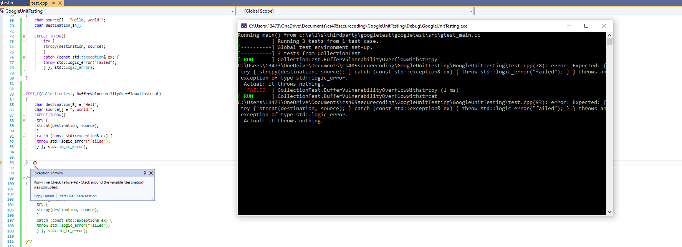
Unit Testing
A negative BufferVulnerabilityOverflowwithstrcat test that yields a buffer overflow exception again with strcat method
Notes:
Unit Testing is an integral part of security testing and software development.
Here are negative and positive test cases for STR30-C.
A negative BufferVulnerabilityOverflowWithstrcpy test that yields a buffer overflow exception.
Another negative BufferVulnerabilityOverflowwithstrcat test that yields a buffer overflow exception again with strcat method
A positive PositiveTeststrcpy test that passes the Google Unit testing and causes no failures with implementation of strcpy

Slide 10
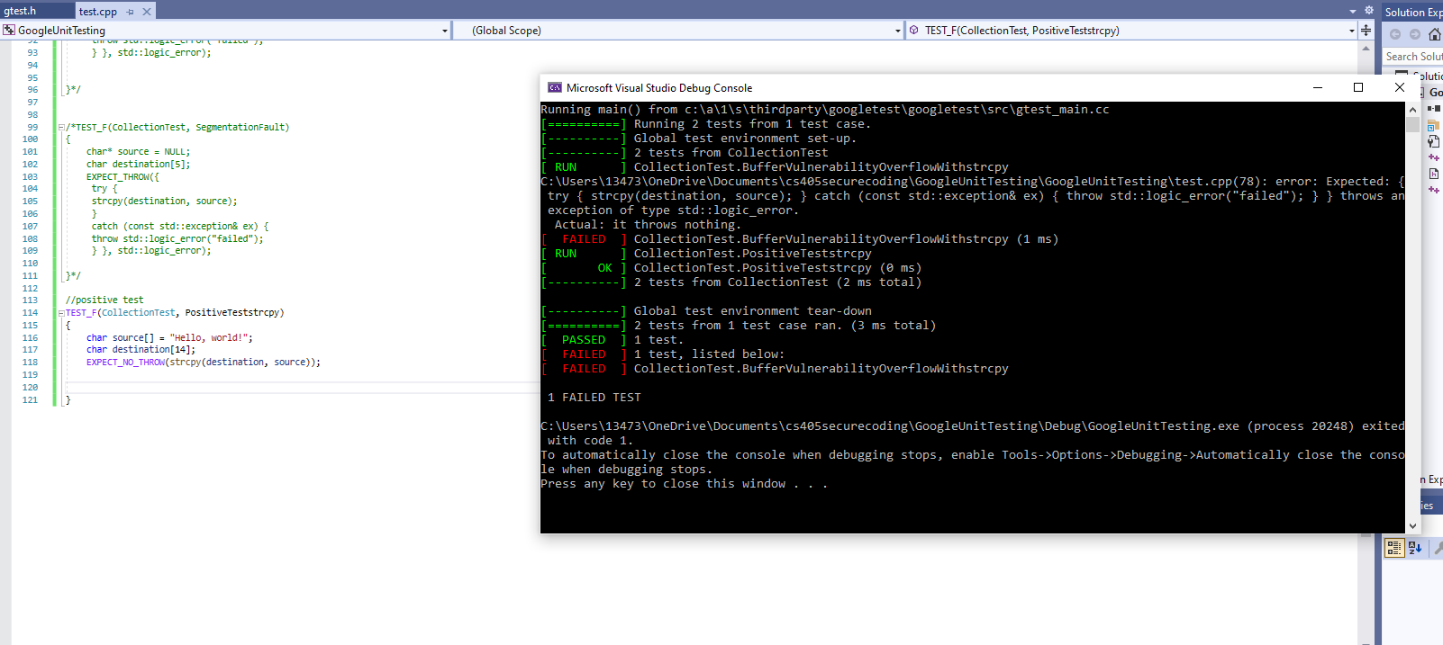
Unit Testing
A positive PositiveTeststrcpy test that passes the Google Unit testing and causes no failures with implementation of strcpy
Notes:
Unit Testing is an integral part of security testing and software development.
Here are negative and positive test cases for STR30-C.
A negative BufferVulnerabilityOverflowWithstrcpy test that yields a buffer overflow exception.
Another negative BufferVulnerabilityOverflowwithstrcat test that yields a buffer overflow exception again with strcat method
A positive PositiveTeststrcpy test that passes the Google Unit testing and causes no failures with implementation of strcpy

Slide 11

AUTOMATION SUMMARY
Notes:
The diagram depicts the security in devops automation process.
DevSecOps stands for development, security, operations. DevOps stands for development and operations.
Starting at pre-production, Assess and Plan stage brainstorms the new threats and potential security attacks.
The architecture of the system provides components that are software or hardware addons.
Design stage may draw out security checks such as OWASP.
In the build stage, secure coding uphold strong security standards and is the bulk of the work.
In the Verify and test stage, certain security vulnerabilities are checked.
Monitor and detect stage use log collections, and analytics in order to catch security vulnerabilities.
The Respond stage adds blocking attacks and limiting services.
In the final stage of Maintain and stabilize, the application is reassessed for potential cyberattacks and held in stable state.

Slide 12
TOOLS
DevSecOps stands for development, security, operations. DevOps stands for development and operations.
Starting at pre-production, Assess and Plan stage brainstorms the new threats and potential security attacks. JIRA is an example.
The architecture of the system provides components that are software or hardware addons.
Design stage may draw out security checks such as OWASP.
In the build stage, secure coding uphold strong security standards and is the bulk of the work.
In the Verify and Test stage, certain security vulnerabilities are checked. Unit Testing is a tool.
Monitor and Detect stage use log collections, and analytics in order to catch security vulnerabilities.
The Respond stage adds blocking attacks and limiting services.
In the final stage of Maintain and Stabilize, the application is reassessed for potential cyberattacks and held in stable state. MaintainX is a maintain code app.
Notes:
The diagram depicts the security in devops automation process.
DevSecOps stands for development, security, operations. DevOps stands for development and operations.
Starting at pre-production, Assess and Plan stage brainstorms the new threats and potential security attacks.
The architecture of the system provides components that are software or hardware addons.
Design stage may draw out security checks such as OWASP.
In the build stage, secure coding uphold strong security standards and is the bulk of the work.
In the Verify and test stage, certain security vulnerabilities are checked.
Monitor and detect stage use log collections, and analytics in order to catch security vulnerabilities.
The Respond stage adds blocking attacks and limiting services.
In the final stage of Maintain and stabilize, the application is reassessed for potential cyberattacks and held in stable state.

Slide 13
RISKS AND BENEFITS
Using DevSecOps
Benefits include but not limited to increase speed and efficiency in software development, enhanced security, improved collaboration in teams, improved compliance with regulations, and improve organization’s trust.
Risks include a shift of culture and mindset, requires some prior knowledge in software development and security, increase complexity of software projects.
Steps include establish security goals objects, conduct a security risk assessment, add a security awareness for all employees, monitor and improve security.
Notes:
There are benefits and risks by using DevSecOps
Benefits include but not limited to increase speed and efficiency in software development, enhanced security, improved collaboration in teams, improved compliance with regulations, and improve organization’s trust.
Risks include a shift of culture and mindset, requires some prior knowledge in software development and security, increase complexity of software projects.
Steps include to establish security goals objects, conduct a security risk assessment, add a security awareness for all employees, monitor and improve security.

Slide 14
RECOMMENDATIONS
Identify gaps in the security policy
Lack of responsibilities in security management
Lack of training, such corporate training videos and tests
More access controls
More incident response procedures, such as security audit
More physical security measures, such as video surveillance and fingerprint
Notes:
Here are my recommendations to identify gaps in the security policy
Lack of responsibilities in security management
Lack of training, such corporate training videos, and tests
More access controls
More incident response procedures, such as security audit
More physical security measures, such as video surveillance and fingerprint

Slide 15
CONCLUSIONS
Standards that should be adopted to prevent future problems.
Adopt a security standard such as ISO or NIST cybersecurity framework
Identify and mitigate organizations security risks
Establish security goals such as Report all potential threats of http requests every month
Provide security training for all employees
Practice Defense in Depth in the organization, such as implement a firewall, limited traffic http protocols
Utilize external security programs and resources, such as a gray hat hacker
Notes:
Here are my conclusions. Standards that should be adopted to prevent future problems

Slide 16
REFERENCES
Defense-in-depth. CyberArk. (2021, September 28). Retrieved April 14, 2023, from https://www.cyberark.com/what-is/defense-in-depth/
Manage your maintenance and Operations. MaintainX. (n.d.). Retrieved April 15, 2023, from https://www.getmaintainx.com
What is DevSecOps? Red Hat - We make open source technologies for the enterprise. (n.d.). Retrieved April 15, 2023, from https://www.redhat.com/en/topics/devops/what-is-devsecops
Notes:
Thank you! Questions or Comments?

